Slide 1

Case Study - Aura films
William Jesney

Slide 2


What does Aura films do?
Aura films are a video production company based in East Anglia working with clients in Essex, Suffolk, Cambridgeshire, London and across UK. They work on any video production from commercials to instructional videos.

Slide 3
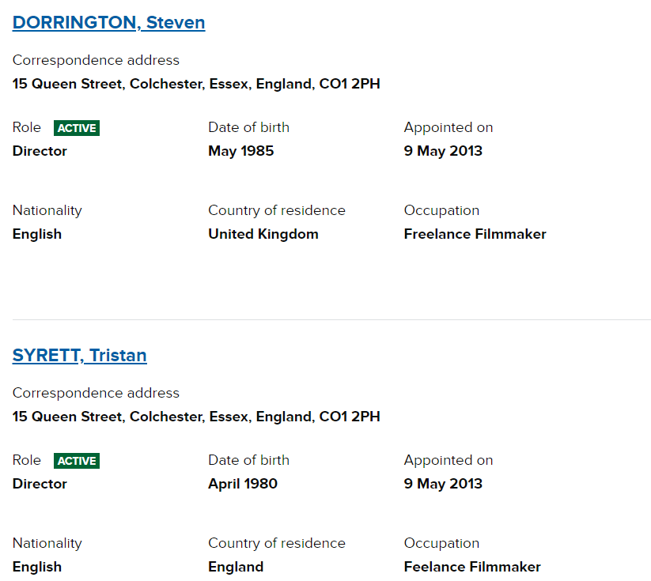
How is Aura films staffed?
According to companies house Aura films has two members; Steven Dorrington and Tristan Syrett both of who are listed as ‘directors’ and ‘freelance filmmakers’ which means they are both self-employed. Steven has more control over the company than Tristan.

Slide 4

What is Aura films Logistics?
Aura films day to day runnings involve producing content for clients that is used online. They gain customers from their website and word of mouth such as previous clients recommending them and previous videos.

Slide 5

How is Aura films similar to my company?
Despite the obvious of Aura films being a video production company, they are based in Colchester and do undertake some promotional videos, Similar to my company. Promotional videos they have made include; Essex Book festivals, Essex business school and Ispy Colchester.

Slide 6

How is Aura films different to my company?
Despite being based in Essex, Aura films work with clients across the UK where as for now I am only working in Essex and surrounding areas. On top of that Aura films undertake any video production where as I specialise in promotional videos.

Slide 7
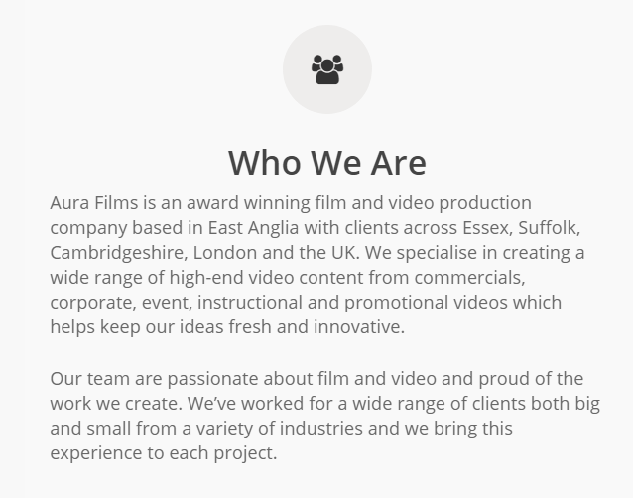
How is Aura films similar to other companies?
Aura films are similar to other video production companies in that they work across the UK and produce many different types of video.

Slide 8

How is Aura films different to other companies?
Looking at their showreel Aura films have a large amount of experience and have become finalists for awards such as Essex Digital awards 2018 and global entertainment awards something which other companies lack.

